Slide 1

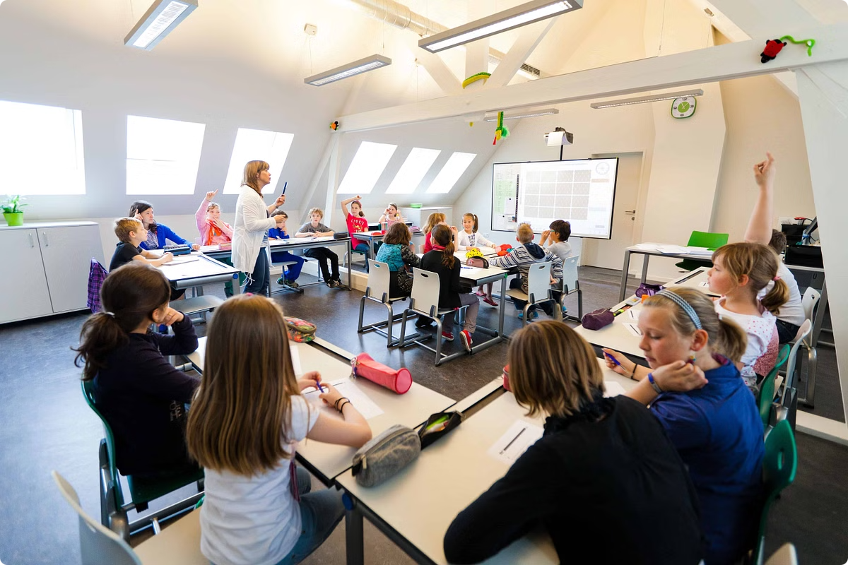

REVOLUTIONALISING EDUCATION : Introducing Our Innovative Platform - Munnin Presented by RYAN INTERNATIONAL SCHOOL INDORE
Our cutting-edge education platform is transforming the way students learn, with personalized experiences, engaging content, and powerful learning algorithms. Discover a new era of educational excellence.

Slide 2


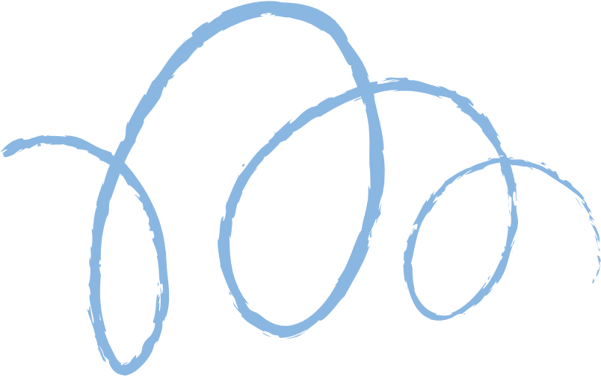


Why Munnin ?
In Norse Mythology, Huginn and Muninn were the crows of Odin, who would search the land for any knowledge to bring to him, and thus we came to Muninn, a website which scours the net for knowledge to give to it’s rightful owners - everyone.
Muninn is meant as an aid for everyone, but especially for children studying in vernacular languages, who have to live with a subpar education because of a lack of resources

Slide 3
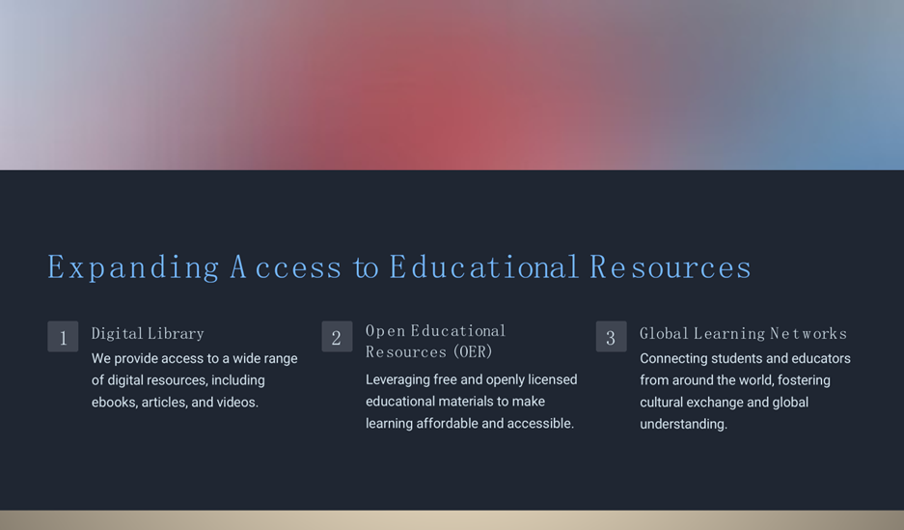


Slide 4


Personalized Learning Experiences
Adaptive Curriculum
Interactive flashcards
Our platform adapts to each student's unique needs, providing personalized lesson plans and content tailored to their strengths and weaknesses.
Engaging short flashcards and hands-on activities keep students motivated and invested in their own learning journey.
Progress Tracking
Real-time performance data allows students, teachers, and parents to monitor progress and identify areas for growth.

Slide 5
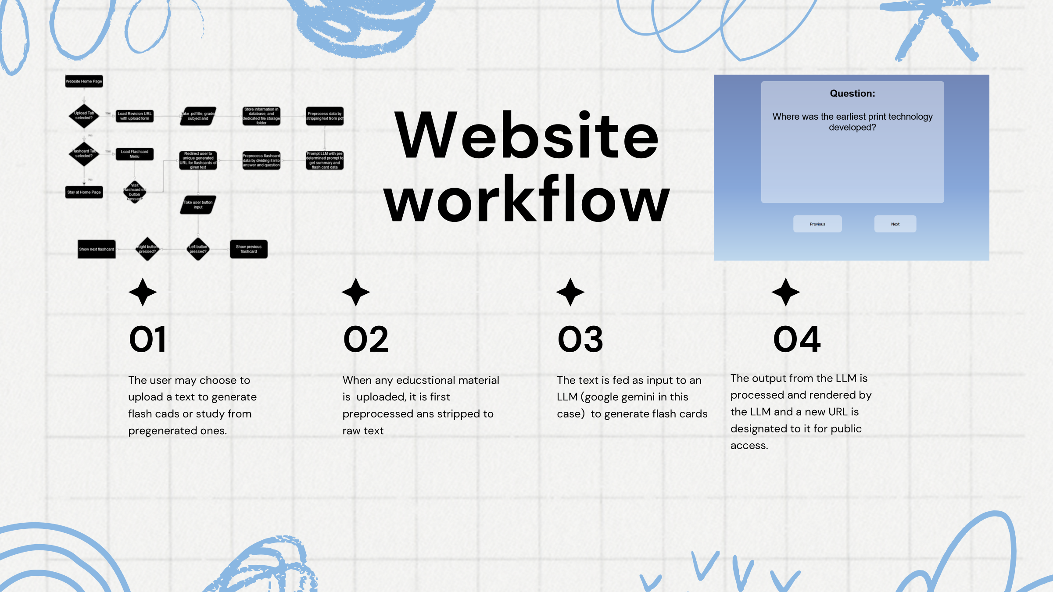

Slide 6
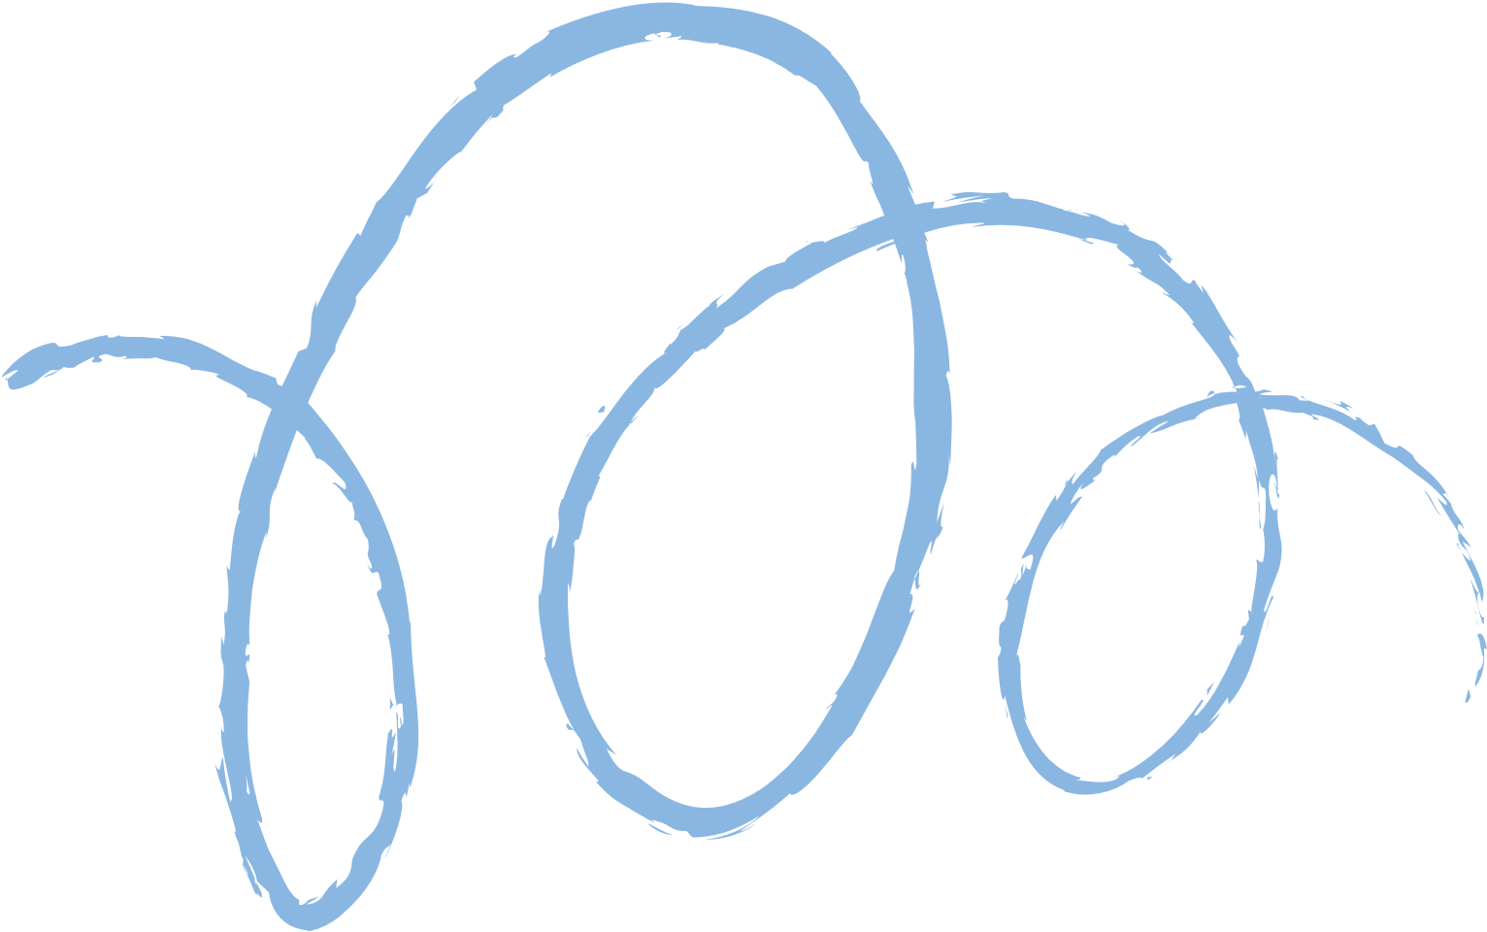
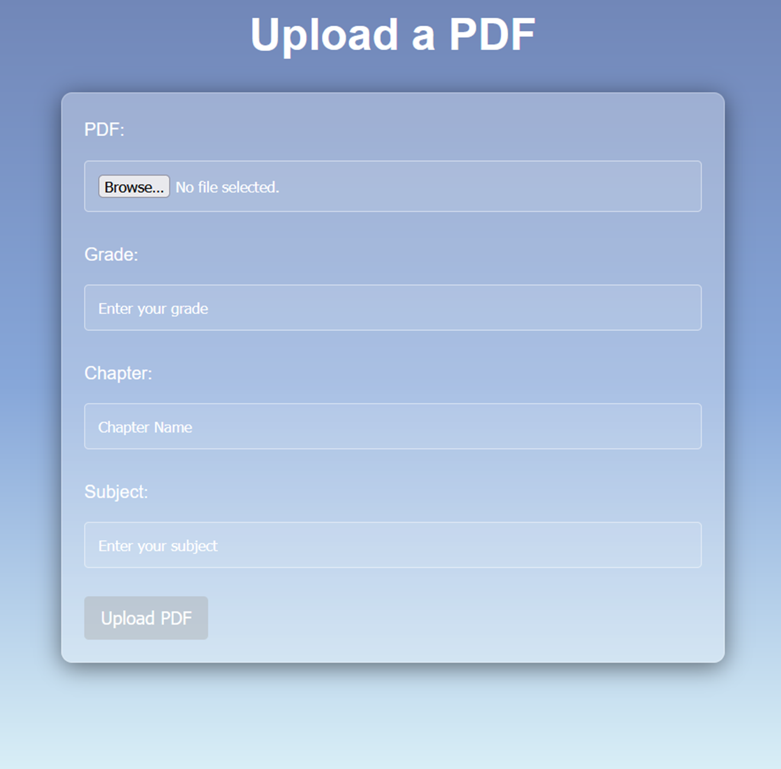

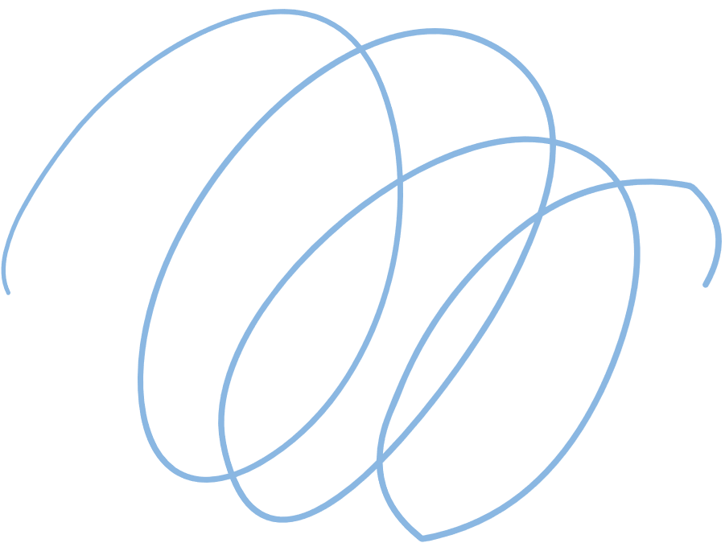
The pdf upload form, used for submitting educational material and other Information about the text.

Slide 7
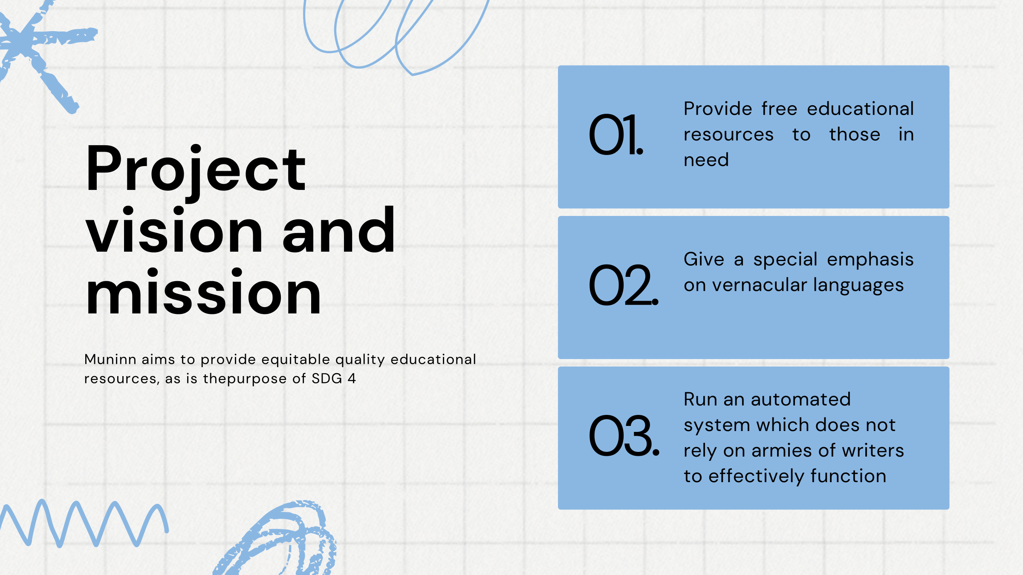

Slide 8
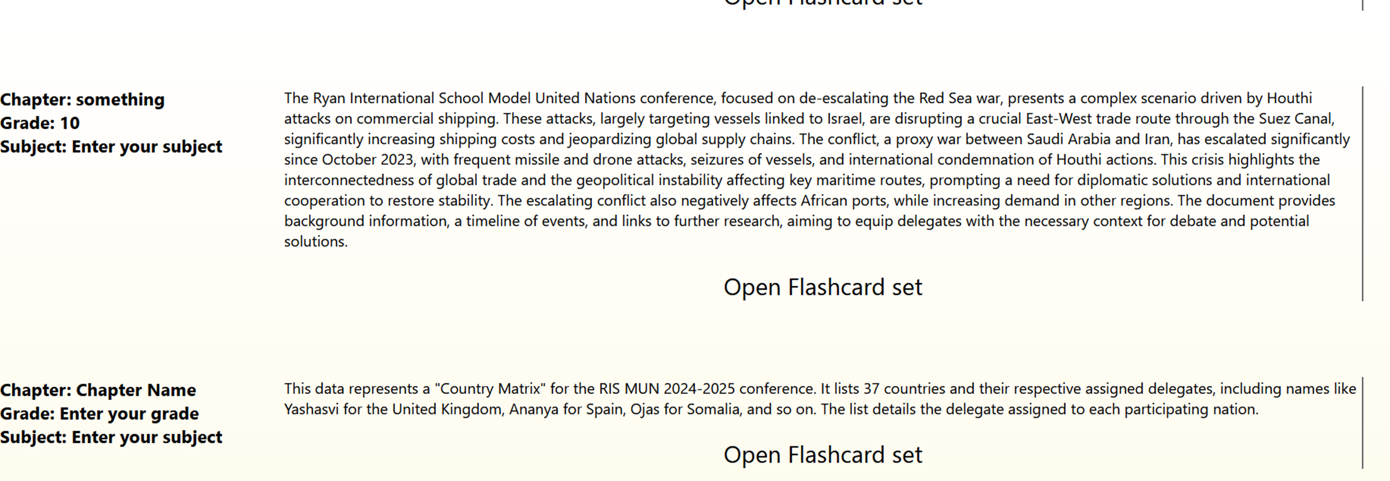
Flash Card
The Flash Card Menu, used to navigate between different flashcard sets and through the website. Each title card shows the subject, grade, chapter name, and a little generated summary
The Flashcard user interface, made using python for backend, and HTML, CSS and Javascript for the frontend. The data for the flash card sets were stored in an sqlite 3 database

Slide 9


